Slide 1
Introduction to Machine Learning Machine Learning: An Overview
Xiaochun MAI
Shenzhen University

Slide 2
Outline
Course Introduction
Definitions of Machine Learning
Basics of Linear Algebra
Basics of Probability

Slide 3
Information about Instructor
Xiaochun MAI, Assistant Professor at the College of Electronics and Information Engineering, Shenzhen University
Email: maixc@szu.edu.cn
Webpage:
https://ceie.szu.edu.cn/info/1036/2595.htm

Slide 4
Logistics
Lectures
Venue: L2-403. Time: 10:15-11:40 AM, Wednesday
Experimental courses
Venue: L3-311. Time: 10:15-11:40 AM, Friday
Q&A/Consultations
After/between the lectures
Email me
Meet me? Most of the time, I am at Zhizhen Building L6-908-B. You can contact me first by email to make an appointment.

Slide 5
Course Description
Machine learning (ML) is the study of computer algorithms that can improve automatically through experience and by the use of varying data.
This course aims to introduce the concepts, algorithms, techniques on machine learning, including 1) regression, 2) classification, 3) model selection, 4) clustering, 5) deep learning, and cover some applications of machine learning techniques.

Slide 6
Course Objective
At the end of the course, students should
Have a good knowledge of machine learning concepts.
Be familiar with various machine learning algorithms.
Given a dataset and problem statement/task, know how to select appropriate machine learning techniques to analyze data and address the problem.
Experimental course will give you more knowledge on analytics tools (e.g. R, Python) so that we can apply the knowledge learned in this course.
Notes:
Learn the basic data mining tools: Weka, R
Many data mining tasks will be data specific and application driven

Slide 7
Target Audiences
Students who intend to do research in machine learning or related fields
To bridge the gap between the knowledge of maths/algorithms that is needed in advanced research
Students who intend to become a data scientist to apply machine learning techniques to solve real-world applications

Slide 8
Plan for ML (subject to minor changes)
16 Lectures
Overall Introduction (1 Lecture)
Data and Data Exploration (3 Lectures)
Supervised Learning (6 Lectures)
Ensemble Learning (2 Lectures)
Unsupervised learning (3 Lectures)
Deep Learning (1 Lectures)
Course project presentation (Week 12)
Final exam (Week 18-19)
Notes:
Sequential Pattern Mining (Tentatively 0.5 Lecture)

Slide 9
Is the content hard to learn?
As a lecturer, I need to make sure most students can understand majority of key content and know how to apply. ☺
So, for some CS/CE/Math/Engineering students, you should be able to follow my lecture without a lot of difficulties.
If you want to learn sth more challenging or very theoretical, you might be a little disappointed ☹ ☺. You may need to take additional courses.
Notes:
Some students may feel the lecture speed is a bit fast – all the video lectures are available at NTUlearntulearn☺

Slide 10
Assessment
Final Exam (Individual) Continual assessment Course project (Group) Quiz (Individual) Assignments (Individual) Class participation & attendance (Individual) | 40% 50% (10%) (10%) (30%) 10%

Slide 11
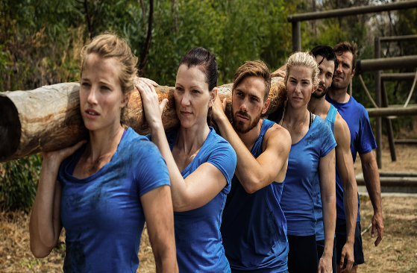
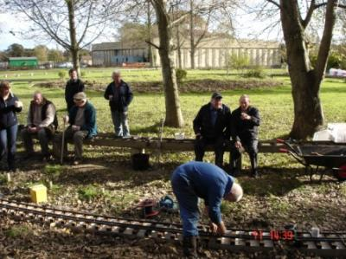

Assessment (Cont.)
Final exam
Term paper
Course project (Group)
Groups of 2-3 members (unless agreeable by me)
Topic: a machine learning task (will be released later)
Submission
Project presentation (by Week 12)
Codes (well documents)
Project report (Week 12)
For a group, I will give individual mark if I found someone did not make significant contribution - when one or multiple members in your group reported to me the issue and I will check with other group members to double confirm.
Each group will provide evaluation marks to all the other groups.

Slide 12
Assessment (Cont.)
Quiz
Closed book and will be conducted on the class of Week 10
Four assignments
Late submission of an assignment would result in a reduced grade for the assignment, unless an extension has been granted by me.
A late submission receives an additional 20% penalty for every 24 hours delay.

Slide 13
Textbook and Reference
Textbook and Reference:
Probabilistic Machine Learning: An Introduction, by Kevin P. Murphy, The MIT Press Cambridge, 2022.
Hands-On Machine Learning with Scikit-Learn, Keras, and TensorFlow, 3nd Edition, by Aurélien Géron, O'Reilly Media, Inc, 2022.
Pattern Recognition and Machine Learning, by Christopher Bishop, Springer, 2007.
The Elements of Statistical Learning, T. Hastie, R. Tibshirani, J. H. Friedman, Springer, 2003.
Convex Optimization, Stephen Boyd, Lieven Vandenberghe, Cambridge University Press, 2004.
Notes:
you can take a look if you have time

Slide 14
Useful Resources
Google Scholar – http://scholar.google.com
Machine Learning
Conference：NIPS、ICML、ECML、COLT，
Journal：《Machine Learning》、《Journal of Machine Learning Research》、《IEEE Transactions on Neural Networks and Learning Systems 》
Data Mining and Artificial Intelligence
Conference：SIGKDD、IJCAI、AAAI、ICDM、SDM、PKDD、PAKDD、WWW
Journal：《ACM Transactions on Knowledge Discovery from Data》、《IEEE Transactions on Knowledge and Data Engineering》
Database
Conference：SIGMOD、VLDB、ICDE、CIKM
Others
《Artificial Intelligence》、
《IEEE Transactions on Pattern Analysis and Machine Intelligence》、
《Neural Computation》

Slide 15
Machine Learning Tools
R
Python
Matlab
Weka
RapidMiner
Orange
IBM SPSS modeler
SAS Data Mining
Oracle Data Mining
……

Slide 16
Acknowledgement
Thank Prof. Le Ou-Yang very much for his generous help with the content of this course!

Slide 17
Outline
Course Introduction
Definitions of Machine Learning
Basics of Linear Algebra
Basics of Probability

Slide 18
Course outline
Overview of machine learning (today)
Classical supervised learning
Linear regression, Logistic regression, Linear discriminant analysis (LDA), Support vector machines (SVMs), Decision trees, Nearest neighbors, Naive Bayes, Ensemble learning
A little bit of theory, a lot of applications
Classical unsupervised learning
Clustering
Mixture models, Expectation maximization (EM)
Dimensionality reduction
Deep learning

Slide 19
Lecture outline
Goal: Provide a framework for understanding all the detailed content to come, and why it matters
Learning: why, what and how
Supervised learning
Unsupervised learning
Basics of Linear Algebra
Basics of Probability

Slide 20
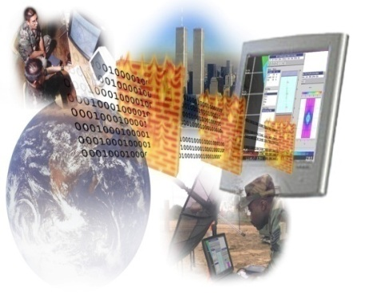

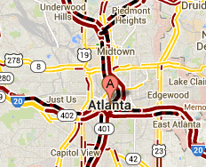
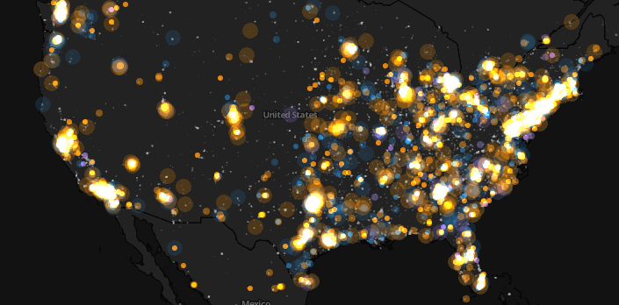
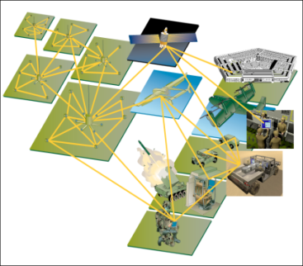
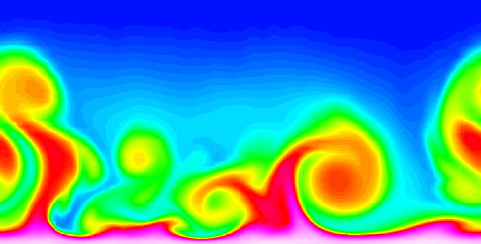
Large-scale Data is Everywhere!
There has been enormous data growth in both commercial and scientific databases due to advances in data generation and collection technologies.
New mantra
Gather whatever data you can whenever and wherever possible.
Expectations
Gathered data will have value either for the purpose collected or for a purpose not envisioned.
E-Commerce
Cyber Security
Traffic Patterns
Social Networking: Twitter
Sensor Networks
Computational Simulations

Slide 21
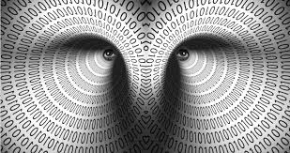








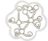





Big Data Analytics
VOLUME
Value (Actionable Insights)
Terabytes
Transactions,
Tables
Files
Processing + Analytics
Big Data
Batch
time series (uniform time interval)
Streams (continuously)
Structured
Unstructured
Semi-structured
VELOCITY
VARIETY
Notes:
A time series is a sequence of data points, measured typically at successive points in time spaced at uniform time intervals. Examples of time series are the daily closing value of the Dow Jones Industrial Average and the annual flow volume of the Nile River at Aswan. Time series are very frequently plotted via line charts.
Stream data flow in and out a computer system continuously.
Impossible for store whole data or scan multiple times due to its huge volume
A time series is a sequence of data points, measured typically at successive points in time spaced at uniform time intervals.
Real-time data denotes information that is delivered immediately after collection. There is no delay in the timeliness of the information provided. Real-time data is often used for navigation or tracking

Slide 22
Big Data Analytics: Why Big Data?
1024 Terabytes = 1 Petabyte
1024 Petabytes = 1 Exabyte
1024 Exabytes = 1 Zettabyte
1024 Zettabytes = 1 Yottabyte
1024 Yottabytes = 1 Brontobyte
1024 Brontobytes = 1 Geopbyte
1 Bit = Binary Digit
8 Bits = 1 Byte
1024 Bytes = 1 Kilobyte
1024 Kilobytes = 1 Megabyte
1024 Megabytes = 1 Gigabyte
1024 Gigabytes = 1 Terabyte

Slide 23
Lots of data
Web: estimated Google index 45 billion pages
Clickstream data: 10-100 TB/day
Transaction data: 5-50 TB/day
Satellite image feeds: ~1TB/day/satellite
Sensor networks/arrays
CERN Large Hadron Collider ~100 petabytes/day
Biological data: 1-10TB/day/sequencer
TV: 2TB/day/channel; YouTube 4TB/day uploaded
Digitized telephony: ~100 petabytes/day

Slide 24
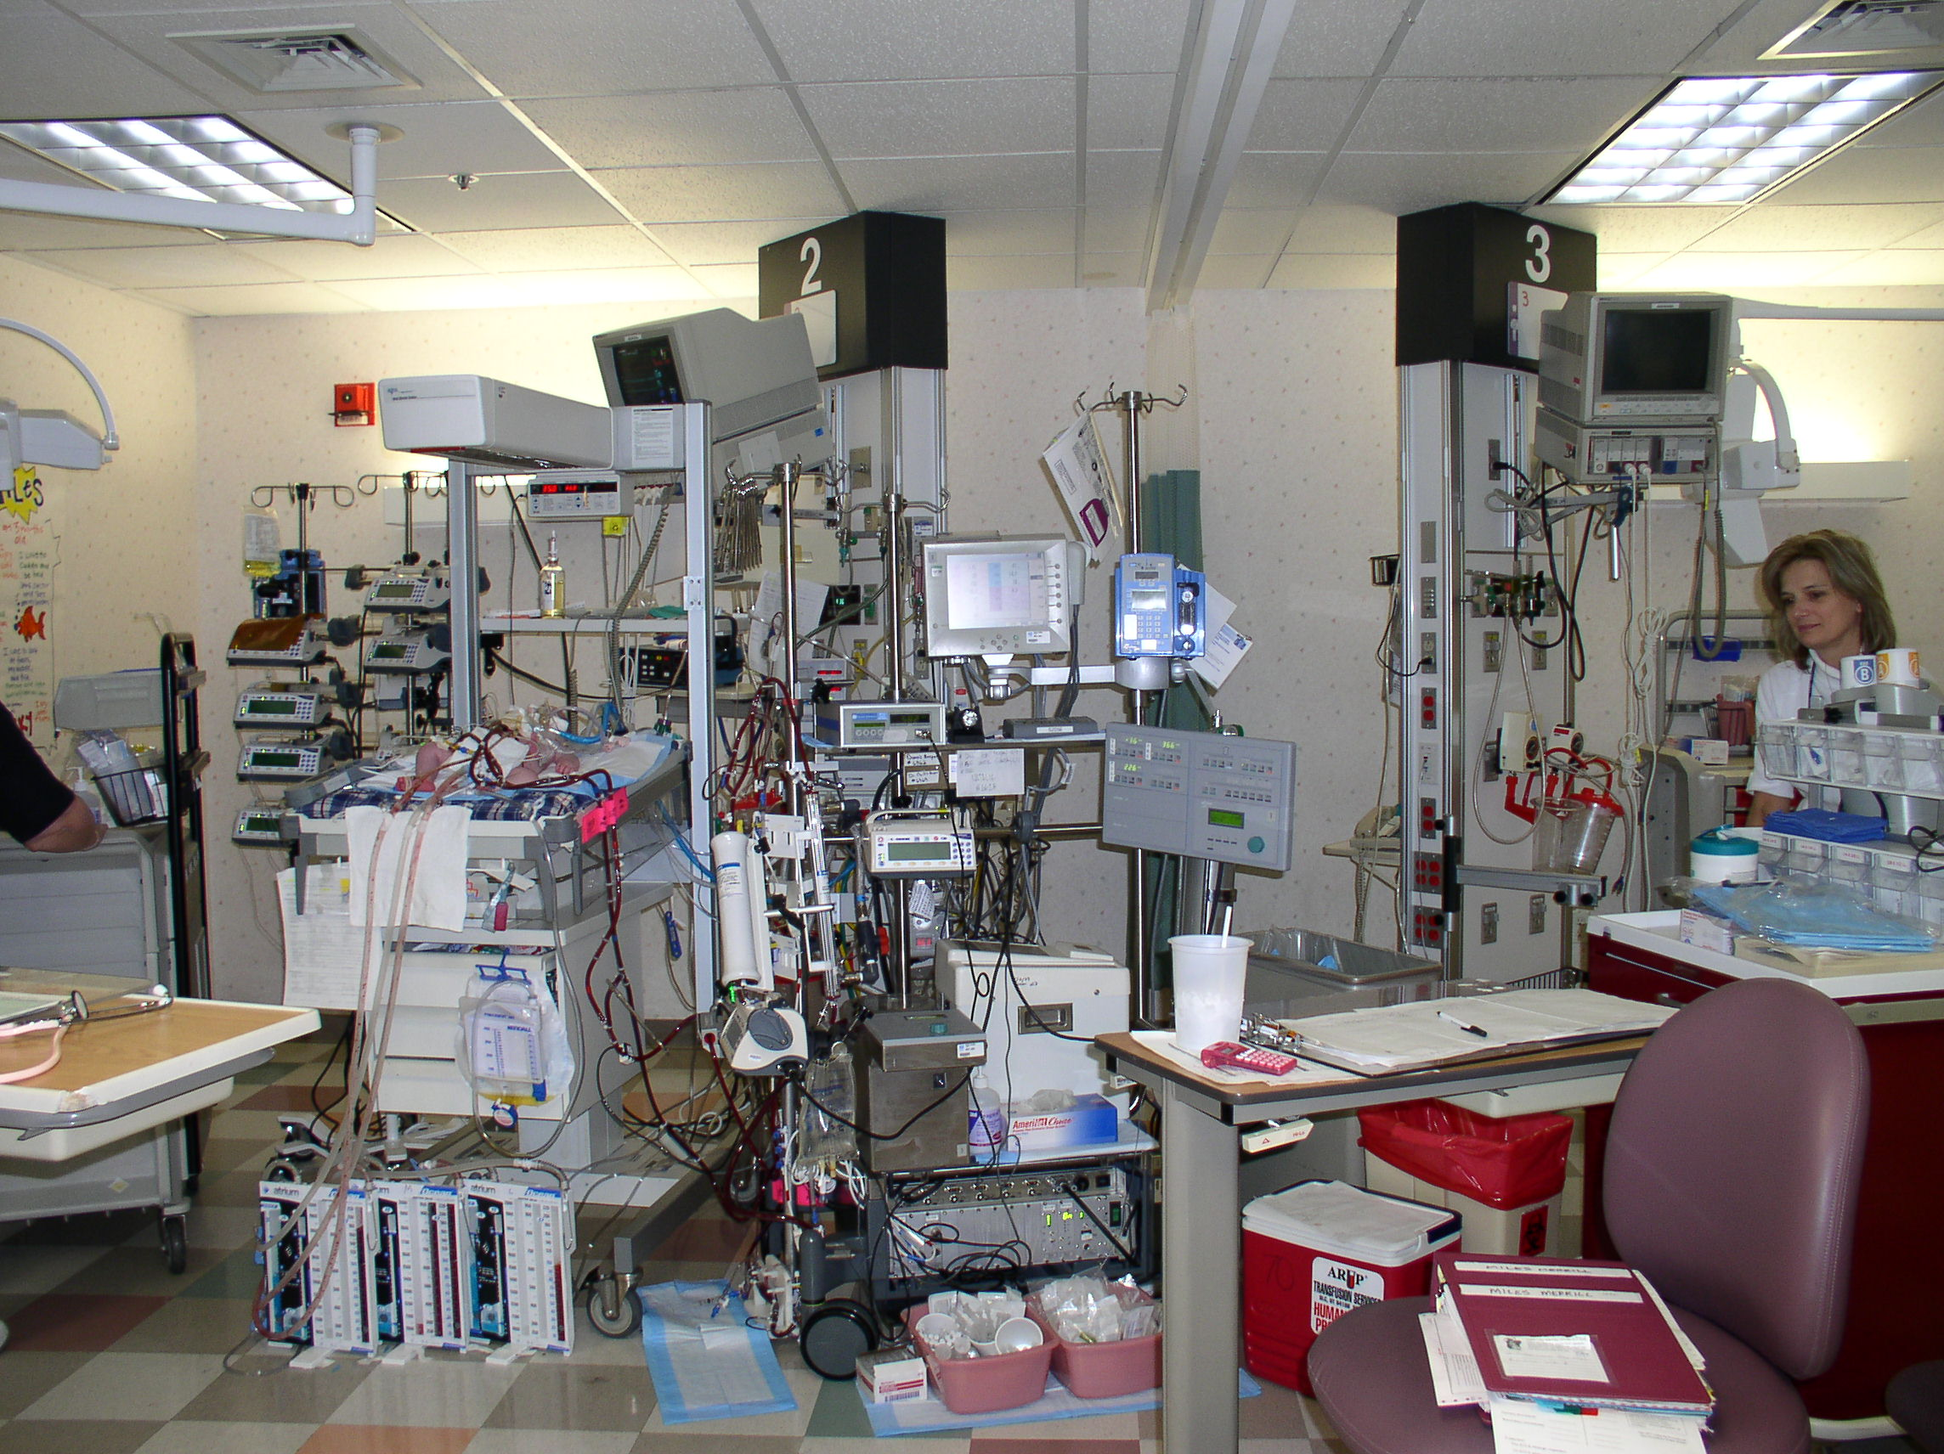
Notes:
This is what an ICU looks like: ventilator, fluids, monitors;
~200 medical procedures per day, many potentially fatal

Slide 25
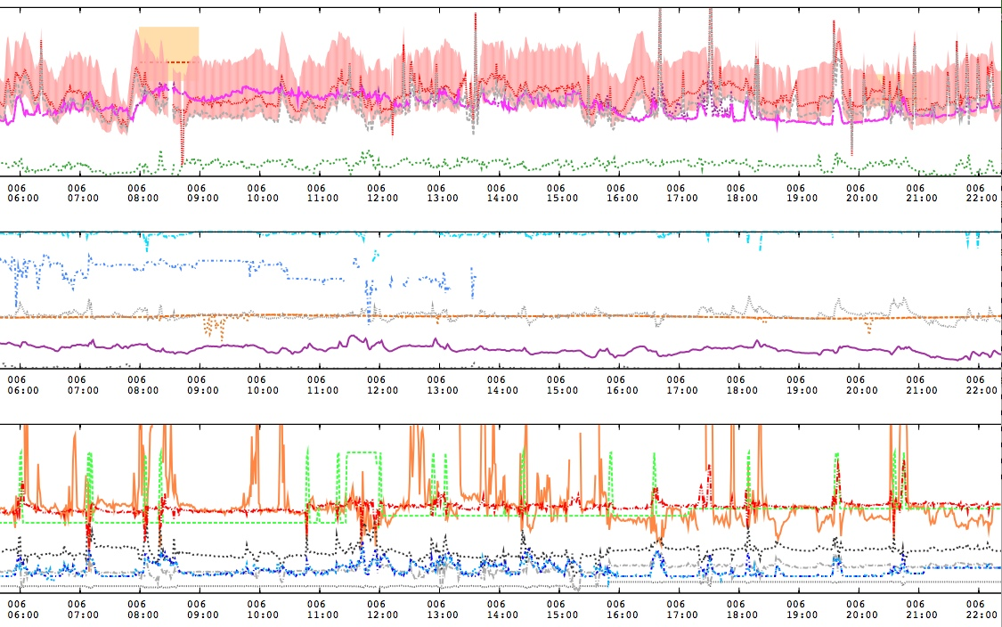
Real data are messy

Slide 26
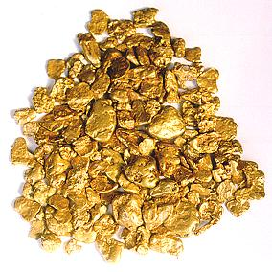
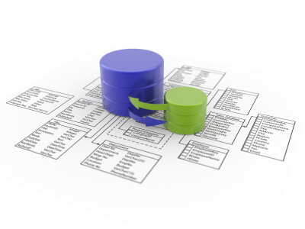
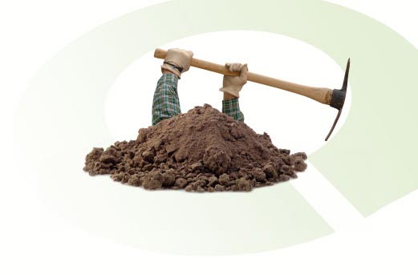

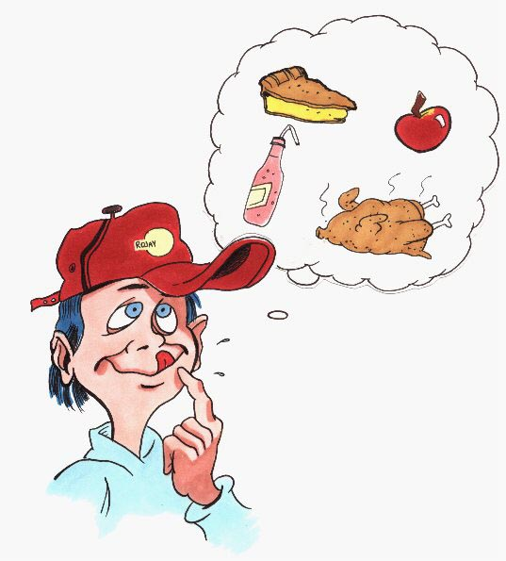
We are drowning in data
But starving for knowledge
Machine Learning
Data are sleeping in many organizations.
No value has been extracted out.
Notes:
Even can cause Overwhelming data frustration
Extraction of interesting (non-trivial, implicit, previously unknown and potentially useful) patterns or knowledge from huge amount of data
Data mining: a misnomer?
Alternative names
Knowledge discovery (mining) in databases (KDD), knowledge extraction, data/pattern analysi

Slide 27
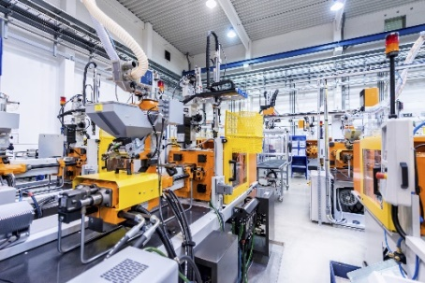
Why Machine Learning? Commercial Viewpoint
Lots of data is being collected and warehoused.
Web data
Purchases at department
Bank/Credit Card
Emails
Manufacturing data
Computers have become cheaper and more powerful.
Competitive Pressure is Strong.
Provide better, customized services for an edge

Slide 28

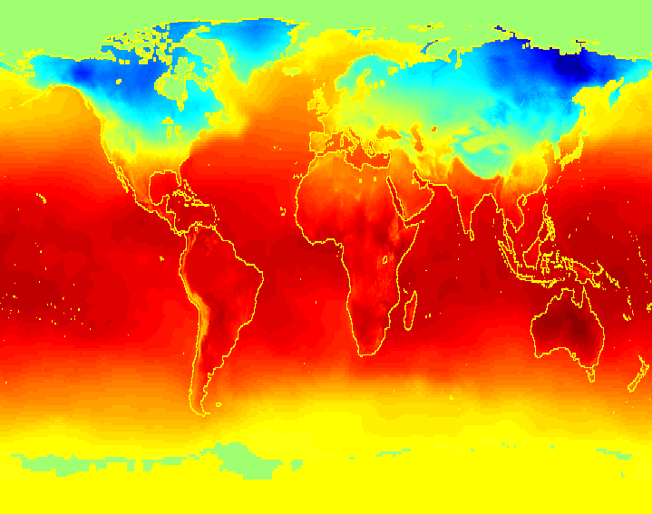
Why Machine Learning? Scientific Viewpoint
Data collected and stored at enormous speeds (GB/hour)
remote sensors on a satellite
telescopes scanning the skies
microarrays generating gene expression data
scientific simulations generating terabytes of data
Traditional techniques infeasible for raw data
Machine learning may help scientists
in classifying and segmenting data
in Hypothesis Formation

Slide 29
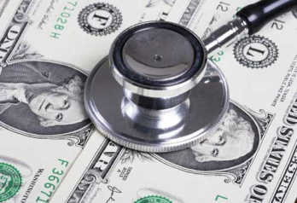
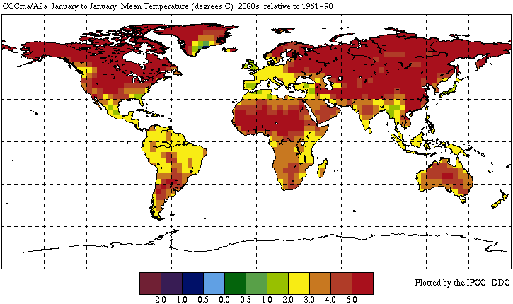
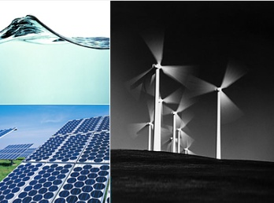
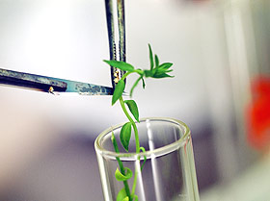
Great Opportunities to Solve Society’s Major Problems
Improving health care and reducing costs
Predicting the impact of climate change
Reducing hunger and poverty by
increasing agriculture production
Finding alternative/ green energy sources

Slide 30
Why not use classical data analysis?
Tremendous amount of data
Algorithms must be highly scalable to handle massive data, such as terabytes/petabytes/Exabyte of data
High-dimensionality of data
E.g., microarray data may have tens of thousands of dimensions
Text data could have hundreds of dimensions
High complexity of data
Data stream, time-series data, temporal data, sequence data
Structure data, graphs, social networks
Heterogeneous databases and legacy databases
Spatial, spatiotemporal, multimedia, text and Web data
Software programs, scientific simulations
New and sophisticated applications

Slide 31
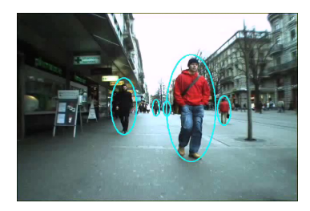
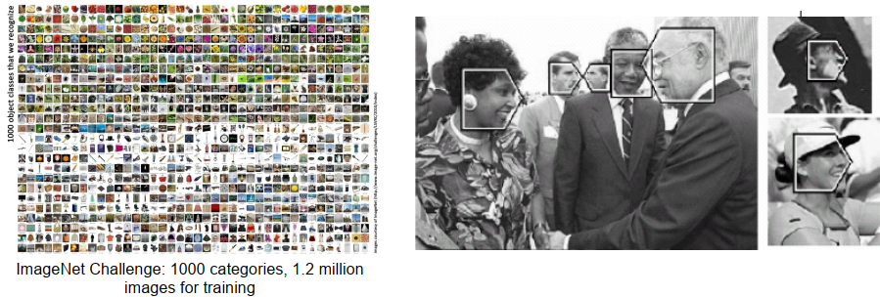
Computer Vision
Object recognition, detection, tracking
Scene segmentation, understanding
Action/hehavior recognition
Image tagging and search
Optical character recognition

Slide 32

Speech Recognition
Speech Recognition: classic problem in AI, very difficult
— “Let's talk about how to wreck a nice beach”
— small vocabulary - easy
— challenges: large vocabulary, noise, accent, semantics

Slide 33
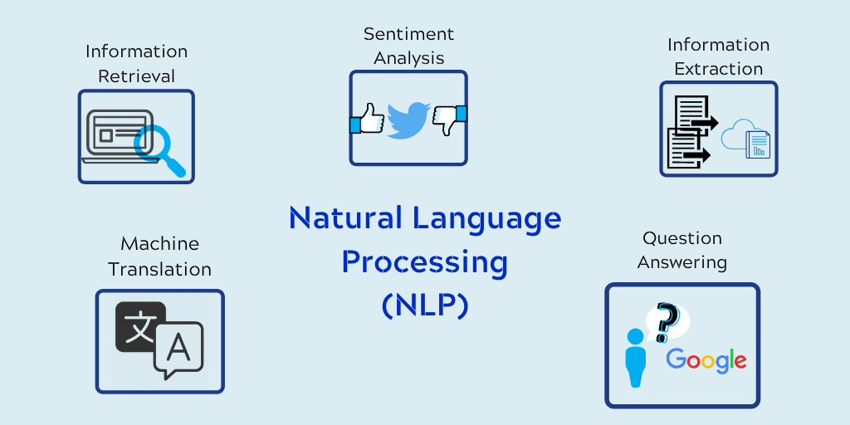
Natural Language Processing (NLP)
Machine translation
Information extraction
Information retrieval, question answering
Text classification, spam filtering, etc

Slide 34
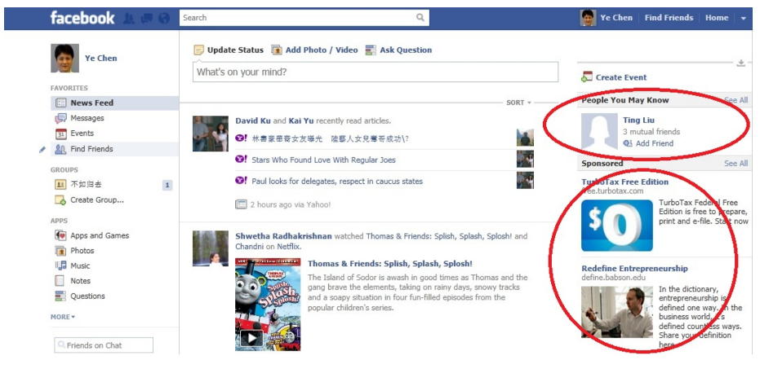
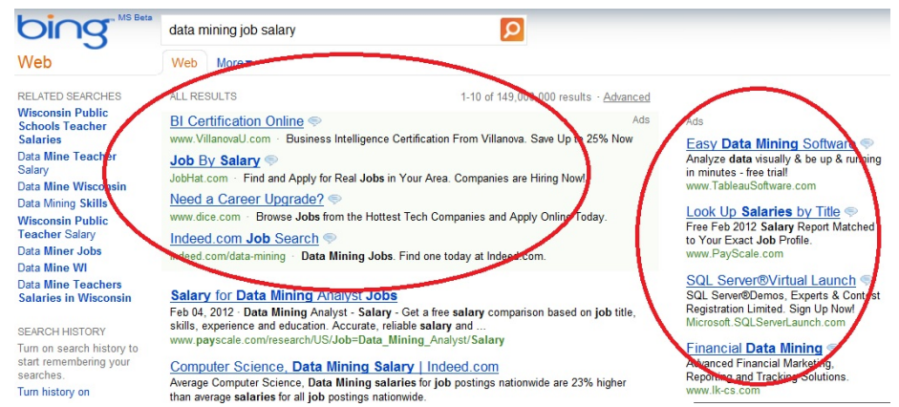
Web Search
Search engine
— Query classification
— Ranking
— Spam detection
Computational advertising
— Estimate click-through rate
— Optimal ads placement

Slide 35
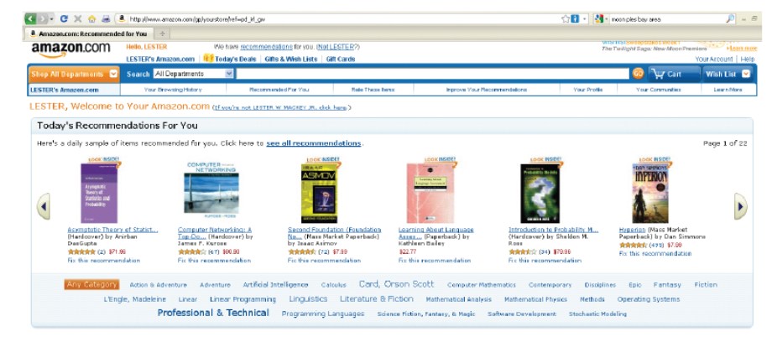
Recommendation
Amazon.com recommends products based on purchase history
Recommendation contributes 35% of sales in Amazon

Slide 36
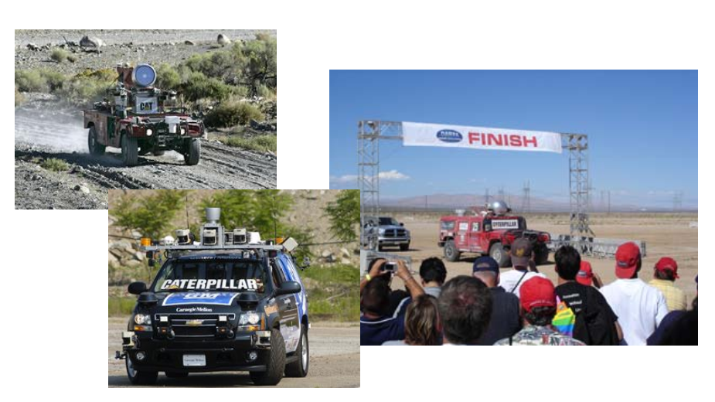
Robotics: driverless car

Slide 37
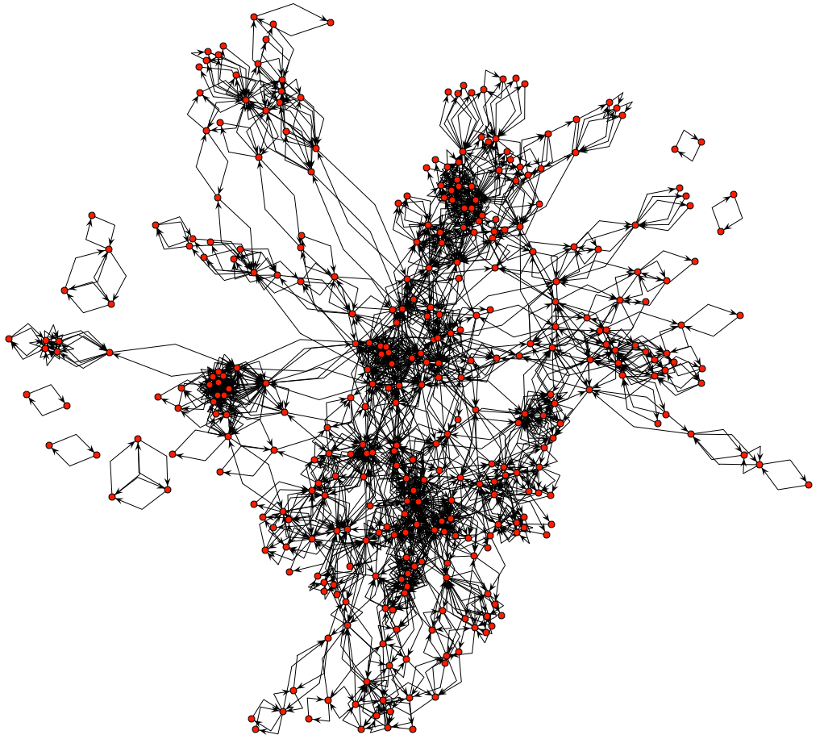
Social network analysis
HP Labs email data
500 users, 20k connections
evolving over time

Slide 38
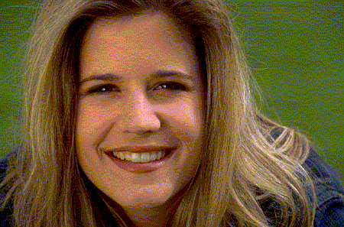
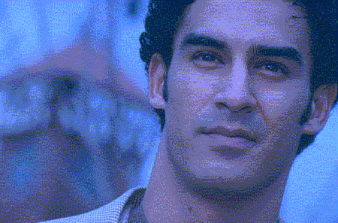
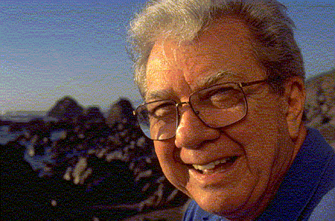
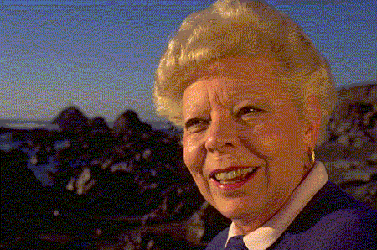
What is Machine Learning?
We have no problem distinguishing man/woman (even when the faces are half covered). But can you explain how? e.g. rules you have used?
No one can write down a clear comprehensive set of rules that work with high precision. However, we can do fairly accurate predictions using machine learning algorithms.
Notes:
we (i.e., humans) have no problem distinguishing man/woman (even when the faces are half covered). But if we ask students/people whether they can give the classification rules they used, no one can write down a clear comprehensive set of rules that work with high precision. Message: sometimes, the classification rules (built by machine learning) cannot easily translated to human-understandable rules and can only be represented in dense math formulas.

Slide 39
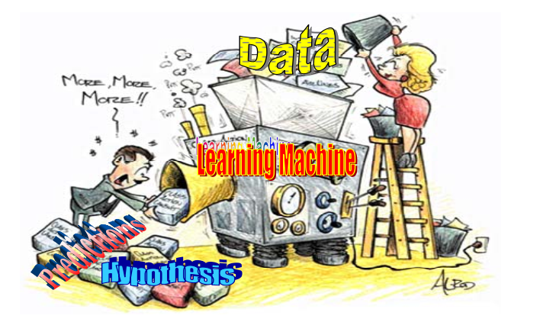
Learning is….
… a computational process for evolving behaviors based on empirical data, ...

Slide 40
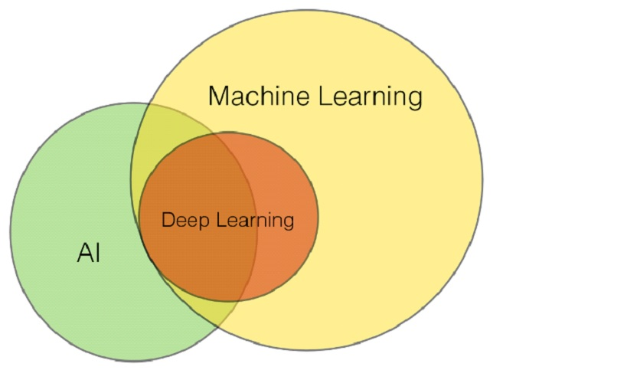
What is Machine Learning ?
Machine learning (ML) is a type of artificial intelligence (AI) that allows software applications to become more accurate at predicting outcomes without being explicitly programmed to do so. Machine learning algorithms use historical data as input to predict new output values.
Supervised learning
- Build a mathematical model of a set of data that contains both the inputs and the desired outputs.
Unsupervised learning
- Take a set of data that contains only
inputs, discover patterns in data.

Slide 41
Supervised learning
To learn an unknown target function f
Input: a training set of labeled examples {(x_{j},y_{j})} where y_{j} = f(x_{j})
Classification: y_{j} is categorical, e.g. topic
Regression: y_{j} is continuous, e.g. temperature, income
Ranking: y_{j} is ordial
Output: hypothesis h that is “close” to f, i.e., predicts well on unseen examples (“test set”)
Many possible hypothesis families for h
Linear models, logistic regression, neural networks, decision trees, examples (nearest-neighbor), grammars, kernelized separators, etc

Slide 42
Example: classification
Predictive
Attributes
Training Examples
id number | Clump Thickness | Uniformity of Cell Size | Uniformity of Cell Shape | Marginal Adhesion | Single Epithelial Cell Size | Bare Nuclei | Bland Chromatin | Normal Nucleoli | Mitoses | Class: (2 for benign, 4 for malignant)
ID1 | 5 | 1 | 1 | 1 | 2 | 1 | 3 | 1 | 1 | 2
ID2 | 5 | 4 | 4 | 5 | 7 | 10 | 3 | 2 | 1 | 2
ID3 | 3 | 1 | 1 | 1 | 2 | 2 | 3 | 1 | 1 | 4
ID4 | 8 | 10 | 10 | 8 | 7 | 10 | 9 | 7 | 1 | 4
Find a model for class attribute as a function of the values of other attributes.
f (Clump Thickness, Uniformity of Cell Size, …, Mitoses) = Class
f(4, 6, 5, 6, 8, 9, 2, 4)=?
A test example

Slide 43
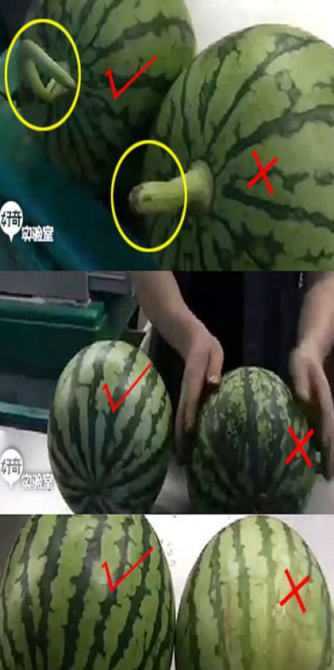
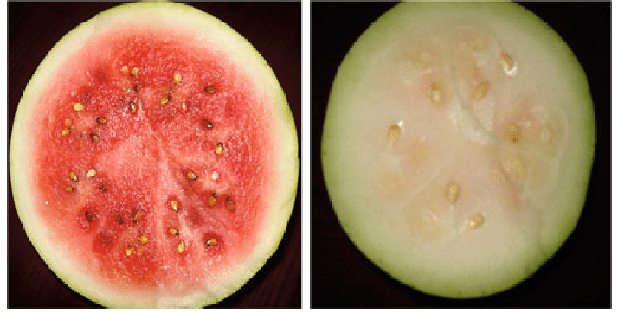
Example: Watermelon Ripeness Determination
Watermelon Training set
We go to supermarket to buy a watermelon. Which one is a good one? You use the model in your brain to predict. Perhaps you will use size, colour, shape root, and acoustic signal. If your model is not accurate, you cannot find good ones☺ The reason could be the quality of your sensors, less training data etc. The sales guy could be much more accurate.
ID | Color | Shape of Root | Sound | Ripeness
1 | Green | Curl | Dull | Y
2 | Black | Curl | Dull | Y
3 | Green | Stiff | crisp | N
4 | Black | Stiff | Dull | N
There are 3 normal features and 1 target feature. This is a binary classification problem. Objective is to learn an accurate model to help us to pick good watermelon
If we have many training data and quality sensors, we can build a very accurate model using machine learning. In addition, we could learn rules/insights, e.g. which feature is the most important one and which two could be used together to build a better model
Perhaps to build a mobile app to make $

Slide 44
Classification Example
categorical
categorical
continuous
class
Test
Set
Training
Set
Learn
Classifier
Model

Slide 45
Example of a Decision Tree
categorical
categorical
continuous
Splitting Attributes
class
Refund
Yes
No
NO
MarSt
Single, Divorced
Married
TaxInc
NO
< 80K
> 80K
NO
YES
Training Data
Model: Decision Tree

Slide 46
Another Example of Decision Tree
categorical
categorical
continuous
class
MarSt
Single, Divorced
Married
NO
Refund
Yes
No
NO
TaxInc
< 80K
> 80K
NO
YES
There could be more than one tree that fits the same data!
Training Data

Slide 47
Decision Tree Classification Task
Decision Tree

Slide 48
Apply Model to Test Data
Test Data
Start from the root of tree.
Refund
Yes
No
NO
MarSt
Single, Divorced
Married
TaxInc
NO
< 80K
> 80K
NO
YES

Slide 49
Apply Model to Test Data
Test Data
Refund
Yes
No
NO
MarSt
Single, Divorced
Married
TaxInc
NO
< 80K
> 80K
NO
YES

Slide 50
Apply Model to Test Data
Test Data
Refund
Yes
No
NO
MarSt
Single, Divorced
Married
TaxInc
NO
< 80K
> 80K
NO
YES

Slide 51
Apply Model to Test Data
Test Data
Refund
Yes
No
NO
MarSt
Single, Divorced
Married
TaxInc
NO
< 80K
> 80K
NO
YES

Slide 52
Apply Model to Test Data
Test Data
Refund
Yes
No
NO
MarSt
Single, Divorced
Married
TaxInc
NO
< 80K
> 80K
NO
YES

Slide 53
Apply Model to Test Data
Test Data
Refund
Yes
No
NO
MarSt
Single, Divorced
Married
Assign Cheat to “No”
TaxInc
NO
NO
< 80K
> 80K
NO
YES

Slide 54
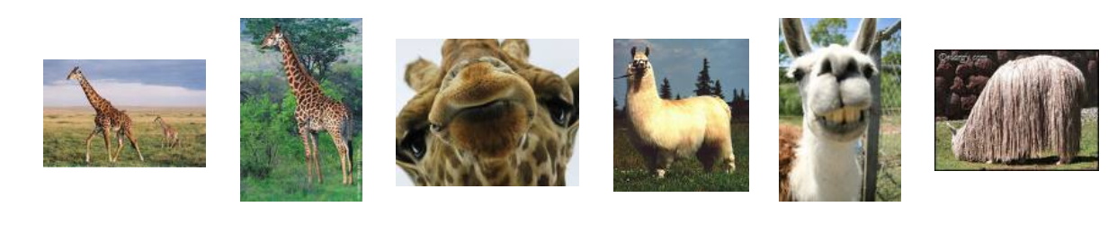
Example: object recognition
x
f(x)
giraffe
giraffe
giraffe
llama
llama
llama

Slide 55
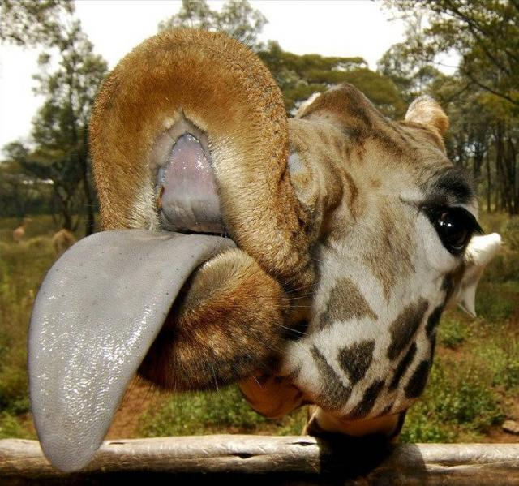
Example: object recognition
x
f(x)
giraffe
giraffe
giraffe
llama
llama
llama
X=
f(x)=?

Slide 56
Classification: Application 1
Direct Marketing
Goal: Reduce cost of mailing by targeting a set of customers likely to buy a new cell-phone product.
Approach:
Use the data for a similar product introduced before.
We know which customers decided to buy and which decided otherwise. This {buy, don’t buy} decision forms the class attribute.
Collect various demographic, lifestyle, and teleco-interaction related information about all such customers.
Type of business, where they stay, how much they earn, etc.
Use this information as input attributes to learn a classifier model.

Slide 57
Classification: Application 2
Fraud Detection
Goal: Predict fraudulent cases in credit card transactions.
Approach:
Use credit card transactions and the information on its account-holder as attributes. When does a customer buy, what does he buy, how often he pays on time, etc.
Label past transactions as fraud or fair transactions. This forms the class attribute.
Learn a model for the class of the transactions.
Use this model to detect fraud by observing credit card transactions on an account.

Slide 58
Classification: Application 3
Customer Attrition:
Goal: To predict whether a customer is likely to be lost to a competitor (e.g. China Mobile -> China Unicom).
Approach:
Use detailed record of transactions with each of the past and present customers, to find attributes.
How often the customer calls, where he calls, what time-of-the day he calls most, his financial status, marital status, etc.
Label the customers as loyal or disloyal.
Find a model for loyalty.

Slide 59
Regression
Goal:
Predict a value of a given continuous valued variable based on the values of other variables, assuming a linear or nonlinear model of dependency.
Extensively studied in statistics, neural network fields.
Examples:
Predicting when the aircraft will land into the airport.
Predicting sales amounts of new product based on advertising expenditure.
Predicting wind velocities as a function of temperature, humidity, air pressure, etc.
Time series prediction of stock market indices.

Slide 60
Difference and Commonality between Classification and Regression
Difference: Regression predicts continuous target (stock price, inventory demand, flight arriving time, weight etc), whereas classification predicts categorical/ discrete labels (e.g. stock up or down, good/bad watermelon, cancer/normal, fraud/normal, underweight/normal/overweight/Obese etc)
Commonality: both of them need training data to learn a model. Many methods can be used for both purpose, e.g. NN, SVM, DT.
Notes:
Normal weight ranges: Body mass index (BMI)
Underweight: BMI is less than 18.5
Normal weight: BMI is 18.5 to 24.9
Overweight: BMI is 25 to 29.9
Obese: BMI is 30 or more

Slide 61
Prediction & Regression: Example 1
Relationship between systolic blood pressure (y), birthweight (x₁), and age (in days) (x₂)
i | Birthweight in oz (x1) | Age in days (x2) | Systolic BP mm HG (y)
1 | 135 | 3 | 89
2 | 120 | 4 | 90
3 | 100 | 3 | 83
4 | 105 | 2 | 77
5 | 130 | 4 | 92
6 | 125 | 5 | 98
7 | 125 | 2 | 82
8 | 105 | 3 | 85
9 | 120 | 5 | 96
10 | 90 | 4 | 95
11 | 120 | 2 | 80
12 | 95 | 3 | 79
13 | 120 | 3 | 86
14 | 150 | 4 | 97
15 | 160 | 3 | 92
16 | 125 | 3 | 88
Training regression model:
Use least-squares method to
determine the regression eqn:
y=53.45 + 0.126 * x₁ + 5.89 *x₂
Prediction using model:
To predict the systolic BP of a baby with birthweight 8 lb (128 oz) measured at 3 days of life
y=53.45+0.126*(128)+5.89*(3)
=87.2mm Hg

Slide 62
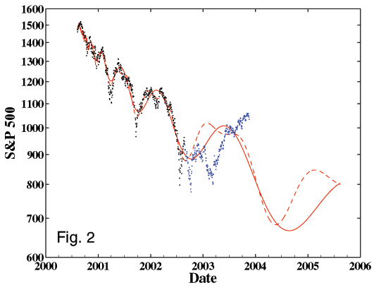
Prediction & Regression: Example 2
Stock Market Prediction
Black dots: training data
Red Line (continuous and dashed): Predictions
Blue dots: test (unseen) actual data
http://www.gold-eagle.com/editorials_03/sornette112403.html

Slide 63
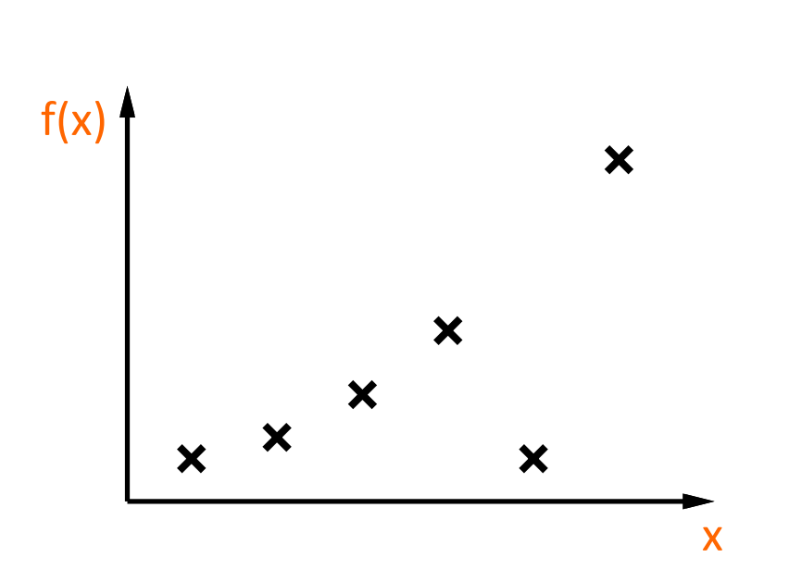
Example: curve fitting

Slide 64
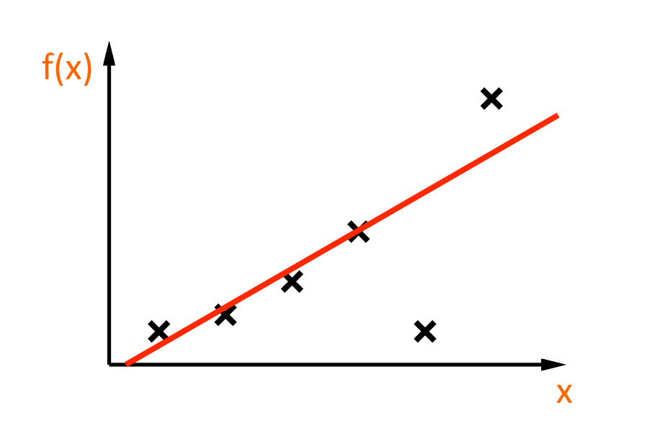
Example: curve fitting

Slide 65
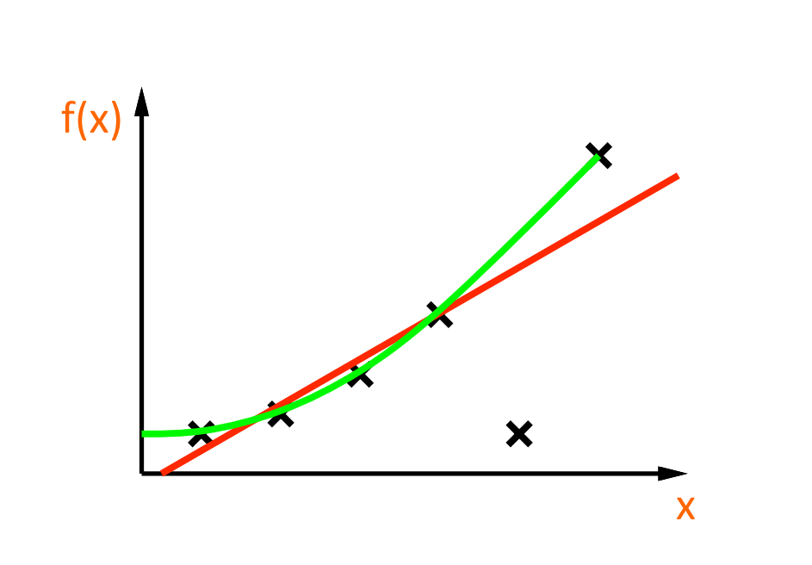
Example: curve fitting

Slide 66
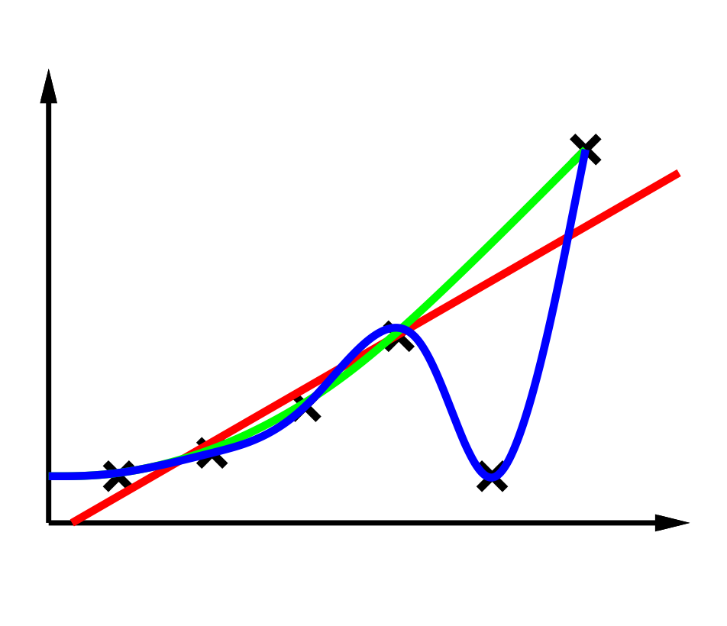
Example: curve fitting

Slide 67
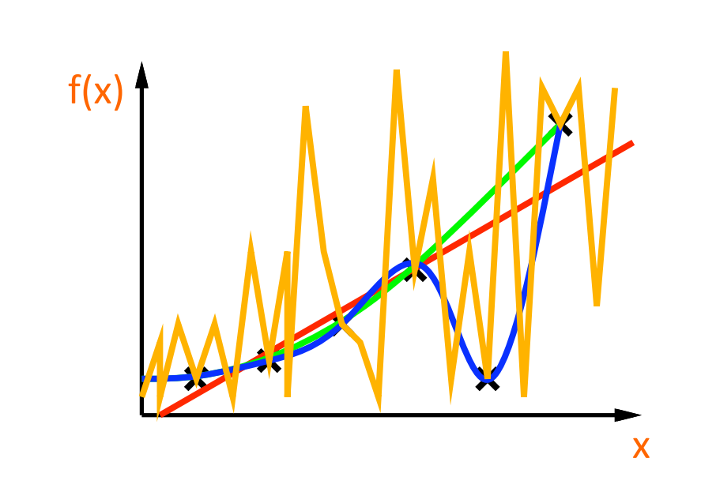
Example: curve fitting

Slide 68
Basic questions
Which hypothesis space H to choose?
How to measure degree of fit?
How to trade off degree of fit vs. complexity?
“Ockham’s razor”
How do we find a good h?
How do we know if a good h will predict well?

Slide 69
Clustering
Finding groups of objects such that the objects in a group will be similar (or related) to one another and different from (or unrelated to) the objects in other groups
Automatically learn the structure of data
Main Principle
C4
C2
Inter-cluster distances
are maximized
Intra-cluster distances
are minimized
C1
C3
C1, C2, C3 are good clusters,
while C4 is a bad cluster

Slide 70
The Input of Clustering
f₁ f₂ f_{n}
D₁ = (V₁₁, V₁₂, …, V_{1n})
Objects D₂ = (V₂₁, V₂₂, …, V_{2n})
Instances ……
points D_{m} = (V_{m1}, V_{m2}, …, V_{mn})
We could use raw data columns as features directly, but it is very important to generate new features (based on domain knowledge, your creativity or preliminary analysis), e.g. ratio of cholesterol/LDL, which is especially important indicators for heart disease detection
f₁ f₂ ,… , f_{n} could be various demographic features race, gender, income, education level, medical features weight, blood pressure, total cholesterol, LDL (low-density lipoprotein cholesterol), HDL (high-density lipoprotein cholesterol), triglycerides (fats carried in the blood), activity features total steps per day, exercise brisk mins, stand hours, move burning calorie, or environmental features like PM2.5, etc.
Notes:
Ratio <4.51
Total chelesterol<200
HDL>40
LDL<130
Key ideas and issues
K-means will converge for most of the similarity measures we have taught

Slide 71
Unsupervised Learning Purely learn from the unlabeled data
We can learn the relationship or structures from data by clustering, e.g. maybe ID1 and ID3 should be in 1 cluster?
id number | Clump Thickness | Uniformity of Cell Size | Uniformity of Cell Shape | Marginal Adhesion | Single Epithelial Cell Size | Bare Nuclei | Bland Chromatin | Normal Nucleoli | Mitoses
ID1 | 5 | 1 | 1 | 1 | 2 | 1 | 3 | 1 | 1
ID2 | 5 | 4 | 4 | 5 | 7 | 10 | 3 | 2 | 1
ID3 | 3 | 1 | 1 | 1 | 2 | 2 | 3 | 1 | 1
ID4 | 8 | 10 | 10 | 8 | 7 | 10 | 9 | 7 | 1
Notes:
Unlike classification, which analyzes class-labeled data objects, clustering analyzes data without class labels

Slide 72
Clustering Definition
Given a set of data points, each having a set of attributes, and a similarity measure among them, find clusters such that
Data points in one cluster are more similar to one another.
Data points in separate clusters are less similar to one another.
Similarity Measures:
Euclidean distance/cosine similarity if attributes are continuous.
Other Problem-specific Measures.

Slide 73
Clustering: Application 1
Market Segmentation:
Goal: subdivide a market into distinct subsets of customers where any subset may conceivably be selected as a market target to be reached.
Approach:
Collect different attributes of customers based on their geographical and lifestyle related information.
Find clusters of similar customers.
Measure the clustering quality by observing buying patterns of customers in same cluster vs. those from different clusters.
Could be turned into classification
Notes:
With training data, revised by human

Slide 74
Clustering: Application 2
Document Clustering:
Goal: To find groups of documents that are similar to each other based on the important terms appearing in them.
Approach: To identify frequently occurring terms in each document. Form a similarity measure based on the frequencies of different terms. Use classic clustering algo or topic modeling to perform clustering. Can describe clusters using keywords
Gain: Information Retrieval can utilize the clusters to relate a new document or search term to clustered documents.

Slide 75
Outline
Course Introduction
Definitions of Machine Learning
Basics of Linear Algebra
Basics of Probability

Slide 76
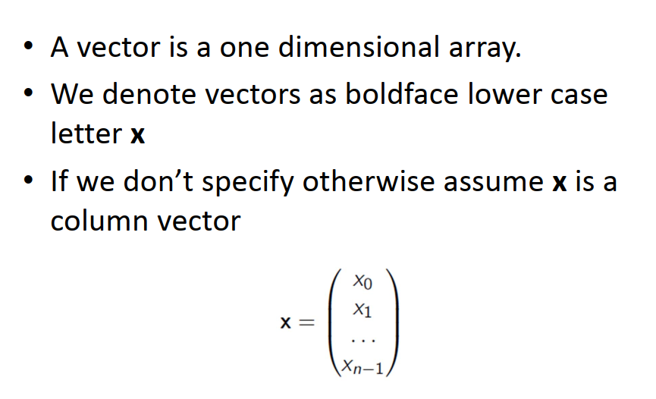
Vector

Slide 77
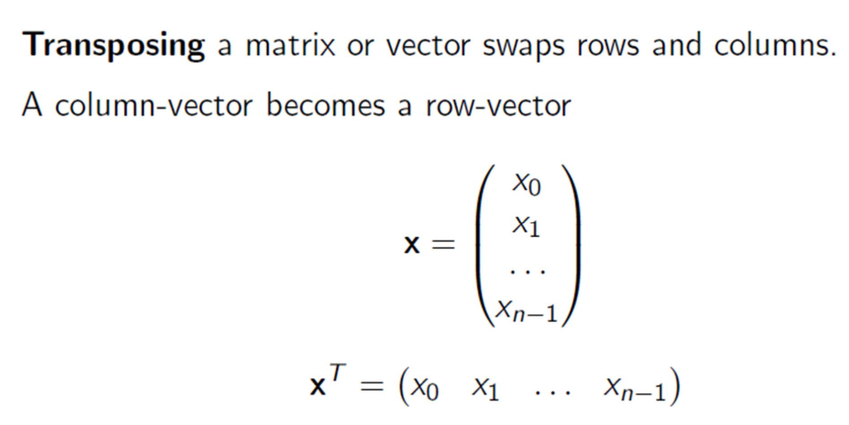
Transposition

Slide 78
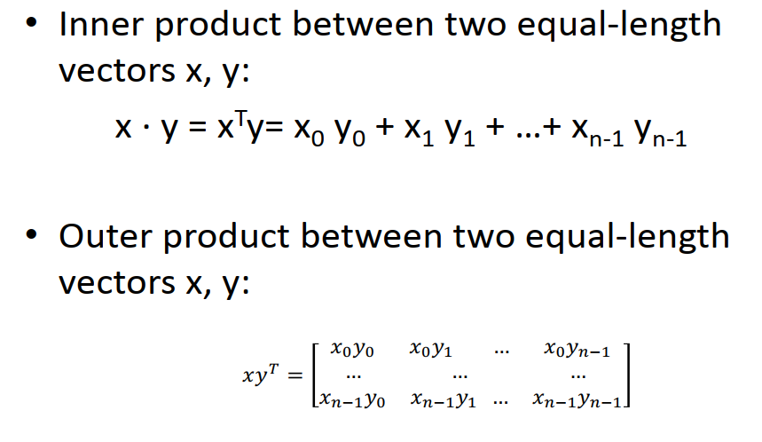
Inner Product and Outer Product

Slide 79
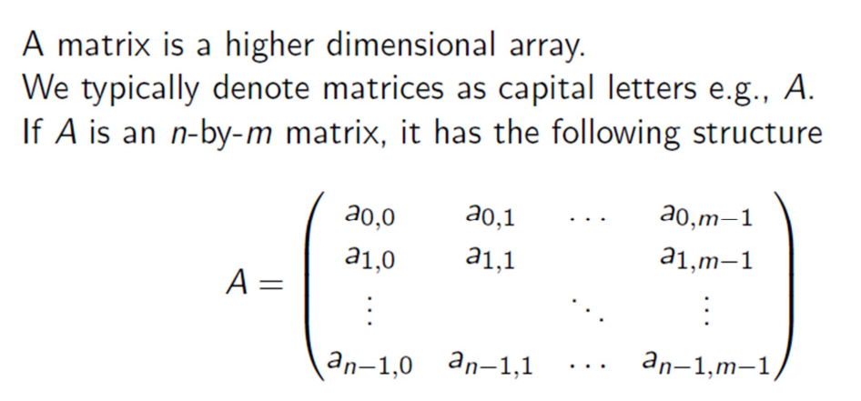
Matrix

Slide 80
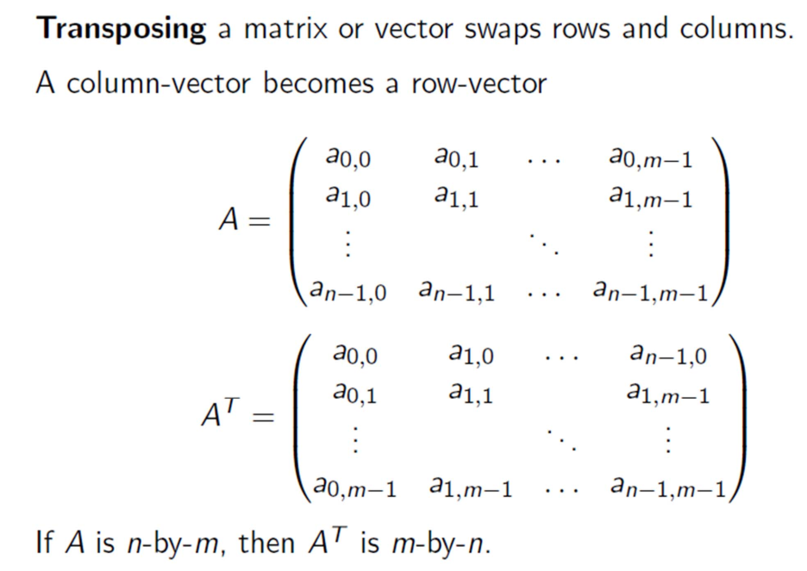
Transpose a matrix

Slide 81

Matrix addition

Slide 82

Matrix multiplication
1

Slide 83
Outline
Course Introduction
Definitions of Machine Learning
Basics of Linear Algebra
Basics of Probability

Slide 84

Basic notations

Slide 85

Priors

Slide 86


Conditional probability
P(A = 1 | B = 1): The fraction of cases where A is true if B is true

Slide 87

Conditional probability

Slide 88

Joint distributions

Slide 89

Joint distributions

Slide 90

Joint distributions

Slide 91

Joint distributions

Slide 92

Joint distributions

Slide 93

Chain rule

Slide 94

Bayes rule

Slide 95

Bayes rule
Likelihood prob
Prior prob
Posterior prob

Slide 96

Probability Density Function
Cumulative Distribution Function (CDF): F(a)

Slide 97

Cumulative Distribution Functions

Slide 98

Expectations

Slide 99

Binomial

Slide 100

Uniform

Slide 101

Gaussian (Normal)

Slide 102

Why Do People Use Gaussians?

Slide 103

Multivariate Gaussians

Slide 104

Covariance examples

Slide 105

Sum of Gaussians
The sum of two Gaussians is a Gaussian:

